Slide 1
8.1 The superposition principle

Slide 2
Introduction
In this topic, we will
Describe the superposition principle
Give some examples
Examine the need for functions that preserve vector space operations

Slide 3
Background
The superposition principle is an observation from physics that there are many systems where the net response at a given place and time caused by two or more stimuli is the sum of the response that would have been caused by each stimulus individually.

Slide 4
The superposition principle
This image shows the superposition of waves:
One specific single wave, a soliton, does not obey the superposition principle when two such waves meet
Photograph by Flickr user Spiralz

Slide 5
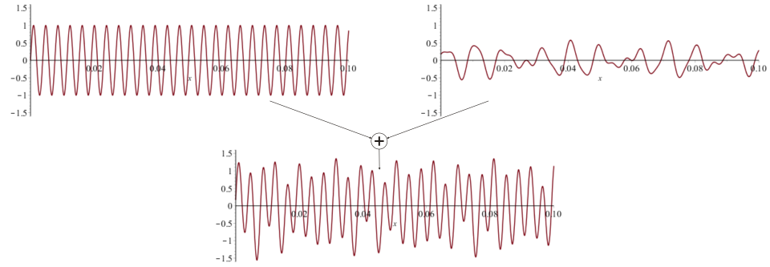
Examples
Here we see middle C combined with noise
One goal of sound engineering is to remove noise

Slide 6
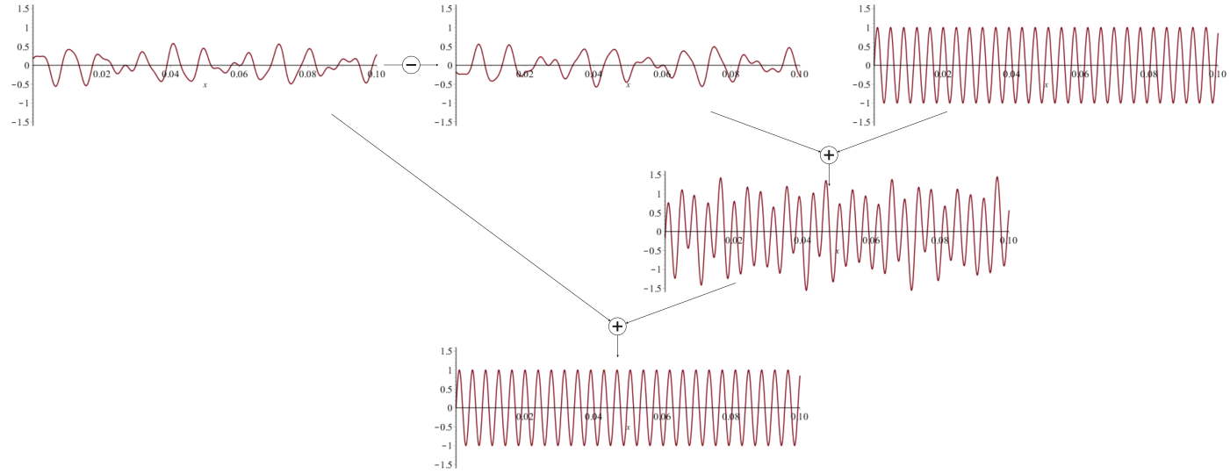
Examples
The goal of noise-cancelling headphones is to:
Estimate the noise vector u
Introduce –u to the sound generated by the headphones
This cancels out the outside noise

Slide 7
Examples
The gravitational and electromagnetic forces also obey the superposition principle

Slide 8
Examples
Also, alternating current (ac) circuits with resistors, inductors and capacitors display a vector-like behavior:
If you double a current, the voltage response double
Scalar multiplication
If you add two currents, the voltage response is the sum of the individual voltage response
Vector addition

Slide 9
Consequence
Engineers prefer to work with mappings that preserve vector space operations
The response to a sum of inputs, should be the sum of the responses to the individual inputs
The response to an attenuated or amplified input, should be the response similarly attenuated or amplified
For example, if you develop a sound system that
Nearly eliminates white noise
Leaves the volumes of human voices essentially unchanged
then when you mix white noise with human voices, the noise should still be eliminated while the human voices remain

Slide 10
Looking forward
Consequently, we will look at linear maps and linear operators:
f (α u + β v) = α f (u) + β f (v)
You have already seen one linear operator
the derivative:

Slide 11
Summary
Following this topic, you now
Know that the superposition principle comes from natural phenomena
Understand these phenomena can be described through vector space operations
Can see the potential need for functions that preserve vector space operations
The response to a linear combination of inputs, is that same linear combination of the individual responses

Slide 12
References
[1] https://en.wikipedia.org/wiki/Superposition_principle

Slide 13
Acknowledgments
None so far.

Slide 14
Colophon
These slides were prepared using the Cambria typeface. Mathematical equations use Times New Roman, and source code is presented using Consolas. Mathematical equations are prepared in MathType by Design Science, Inc.
Examples may be formulated and checked using Maple by Maplesoft, Inc.
The photographs of flowers and a monarch butter appearing on the title slide and accenting the top of each other slide were taken at the Royal Botanical Gardens in October of 2017 by Douglas Wilhelm Harder. Please see
https://www.rbg.ca/
for more information.

Slide 15
Disclaimer
These slides are provided for the ne 112 Linear algebra for nanotechnology engineering course taught at the University of Waterloo. The material in it reflects the authors’ best judgment in light of the information available to them at the time of preparation. Any reliance on these course slides by any party for any other purpose are the responsibility of such parties. The authors accept no responsibility for damages, if any, suffered by any party as a result of decisions made or actions based on these course slides for any other purpose than that for which it was intended.

